Slide 1
Objectives
In this session, you will learn to:
  Overload methods
  Use variable argument methods
  Use inheritance and access levels: private, protected, default, and public
  Use field shadowing
  Use overriden methods

Slide 2
What Is Polymorphism?
Polymorphism:
  Means “many forms”
  Ability to refer to an object using either its actual form or a parent form
The following code snippet shows how polymorphism is used by the emp object:
Employee emp = new Manager();
Here, assignment is legal as a Manager is also an Employee.
Parent class
Child class

Slide 3
Overloading Methods
Methods in a class may have the same name but different arguments, it is known as method overloading.
The rules for method overloading:
  Argument list:
    Must be different
    May differ in their order, number, or type
  Method return types may or may not be different

Slide 4
Methods Using Variable Arguments
A method may take multiple arguments of the same type, as shown in the following code snippet:
  public class Statistics {
  public float average (int x1, int x2) {}
  public float average (int x1, int x2, int x3) {}
  public float average (int x1, int x2, int x3, int x4)
  {}
  }
Such methods can be collapsed into a single method.
This single method has the same name but different number of argument using the varargs feature.
The following embedded Word document shows how to implement varargs in Java.

Slide 5


Activity: StatisticsExample

Slide 6
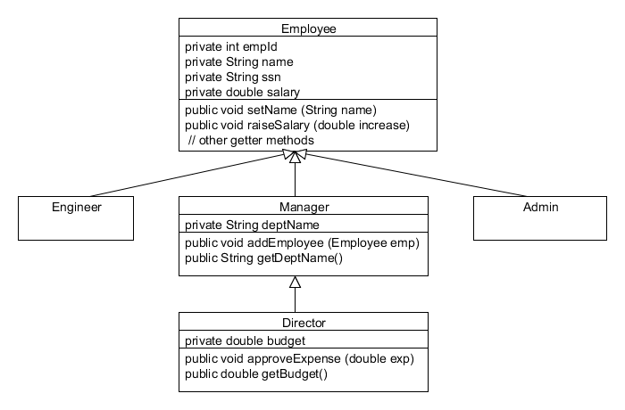
Single Inheritance
Java permits a class to extend from a single class directly.
This is called single inheritance.
The following diagram depicts single inheritance.

Slide 7

Using Access Control
Access levels for fields and methods:
  private
  default
  protected
  public
The following table shows the access levels for a field or a method.
Modifier (keyword) | Same Class | Same Package | Subclass in Another Package | Universe
private | Yes | no | no | no
default | Yes | Yes | no | no
protected | Yes | Yes | Yes* | no
public | Yes | Yes | Yes | Yes

Slide 8
Protected Access Control: Example
The following code snippet shows the declaration of a protected field:
  package demo;
  public class Foo {
  protected int result = 20;
  int other = 25;
  }
subclass-friendly declaration

Slide 9
Protected Access Control: Example (Contd.)
The following code snippet shows the access of the protected and the default fields in a subclass:
  package test;
  import demo.Foo;
  public class Bar extends Foo {
  private int sum = 10;
  public void reportSum ()
  {
  sum += result;
  sum += other;
  }
  }
Subclass
Superclass
Compiler error
The result variable is accessible as it is declared with protected access in the superclass, but the other variable is not accessible as it is declared with default access in the superclass.

Slide 10
Access Control: Good Practice
Good practices for access control:
  If possible, make fields inaccessible.
  Create methods that provide a clear intent for the use of the fields.
The following code snippet demonstrates access control:
  package demo;
  public class Foo3 {
  private int result = 20;
  protected int getResult() { return result; }
  }
  public class Bar3 extends Foo3 {
  private int sum = 10;
  public void reportSum(){
  sum += getResult();
  }
  }
The result field is inaccessible to the other classes. To access it, the getResult() method is created.
The getResult() method is called to access the result field.

Slide 11

Activity: javaAccessExample

Slide 12
Field Shadowing: Example
Field shadowing:
  Occurs when a non-private field of the superclass is also declared in the subclass and the field is hidden in the subclass
  Example: package demo;
  public class Foo2
  {//superclass
  protected int result = 20;
  }
  public class Bar2 extends Foo2 {
  private int sum = 10;
  private int result = 30;
  public void reportSum() {
  sum += result;
  }
  }
The result field shadows the superclass field.

Slide 13

Overriding Methods
Overridden method:
  Non-private method of the superclass that is also defined in the subclass
Rules to override methods:
  At least two classes must exists, a superclass and a subclass
  Method signature of the superclass must be same in the subclass
The following embedded Word document shows how to implement the concept of method overriding.
The super keyword is used to invoke a parent method from a subclass.

Slide 14

Accessibility of Overridden Methods
The following Word document shows the limitation on the use of access specifier in method overriding.

Slide 15

Invoking an Overridden Method
An overridden method invokes the object of the child class.
Parent class object will:
  Invoke the method created in the class itself
  Never have access to overridden method
The following Word document demonstrates the invocation of an overridden method.

Slide 16

Quiz

Slide 17
Quiz (Contd.)
Which of the following options shows the correct implementation of method overloading?
  public int print (int i);
  public void print (int f);
  public void show();
  public string show();
  public void disp (int i);
  public void dispArea (int i);
  public void dostuff(float i);
  public void dostuff(double i);
Solution:
  public void dostuff(float i);
  public void dostuff(double i);

Slide 18
Quiz (Contd.)
Fill in the blank:
  Java permits a class to extend only one other class directly. This is called __________.
Solution:
  single inheritance

Slide 19
Summary
In this session, you learned that:
  Polymorphism means “many forms”.
  The methods with same name but different arguments list in a class are called overloaded methods.
  Varargs or variable arguments can be used to collapse overloaded methods into one method, if the argument list is of the same type but differs in number.
  Java supports only single inheritance by extending existing class into other class.
  The four access modifiers private, default, protected, and public are used to control accessibility of fields and methods of a class.
  When a field of subclass hides a field of superclass, it is known as field shadowing.
  Redefinition of the superclass method into the subclass is known as method overriding.

